Slide 1
DR. HARISINGH GOUR UNIVERSITY
CODECRAFT CHALLENGE — PROBLEM 5
University Research Cell
Full-stack platform and AI assistant for campus R&D ecosystems.
React Native
Node.js
MySQL

Slide 2

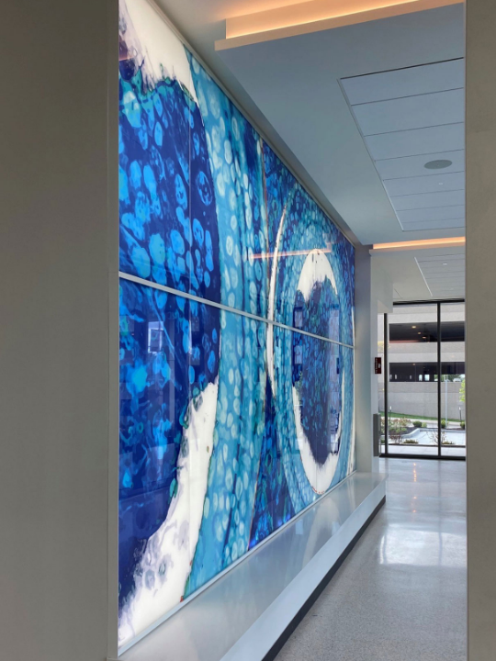
DR. HARISINGH GOUR UNIVERSITY | THE MANDATE
Centralized R&D Hub
Unified Profiles
Faculty directory linked to Scopus and ORCID.
Lifecycle Tracking
Multi-stage pipeline for proposals and grants.
Proactive Alerts
Targeted funding and conference notifications.

Slide 3






DR. HARISINGH GOUR UNIVERSITY | TARGET AUDIENCE
Three Tailored Experiences
Student Suite
Scholar Suite
PI Desk
Faculty mentor matching.
Thesis milestone tracker.
Active R&D portfolio KPIs.
Simplified paper digests.
PMRF / CSIR tracking.
Grant approval desk.
Summer lab internships.
DOI library integration.
Supervised scholars.

Slide 4



DR. HARISINGH GOUR UNIVERSITY | CONVERSATIONAL ENGINE
Context-Aware AI Assistant
Expertise Search
Grant Eligibility
Find faculty by research niche.
Live tracking of SERB & BIRAC limits.
Instant querying across 8 relational databases using natural language.
Proposal Status
IPR Guidance
Real-time approval pipeline lookups.
Patent filing forms and legal support.

Slide 5
DR. HARISINGH GOUR UNIVERSITY | RESILIENCE STRATEGY
Zero-Downtime Architecture
01
02
03
Live Cloud
Memory Fallback
Offline Client
Hostinger MySQL with connection pooling.
In-memory data bypasses 500 errors.
Static local datasets load instantly.

Slide 6

DR. HARISINGH GOUR UNIVERSITY | ECOSYSTEM IMPACT
245+
100%
10x
Active Research Papers
Patent Traceability
Faster Approvals
Zero-Downtime Operations

Slide 7
PHASE 1
External Integrations
Scopus API sync, Crossref DOI fetch, and OAuth2 SSO.
DR. HARISINGH GOUR UNIVERSITY | FUTURE ROADMAP
The Next Evolution
PHASE 2
Advanced LLM Processing
Automated grant proposal scoring and AI literature review.
PHASE 3
Global Scale
Multi-institution SaaS cloud and blockchain timestamps.

Slide 8
DR. HARISINGH GOUR UNIVERSITY
Ready for Demo

